Slide 1
Snake Fight Game
Daulton Kowtek, Cory Efird

Slide 2
Problem Definition
Make a game where you fight a big snake.
Melee combat.
On a sphere!

Slide 3
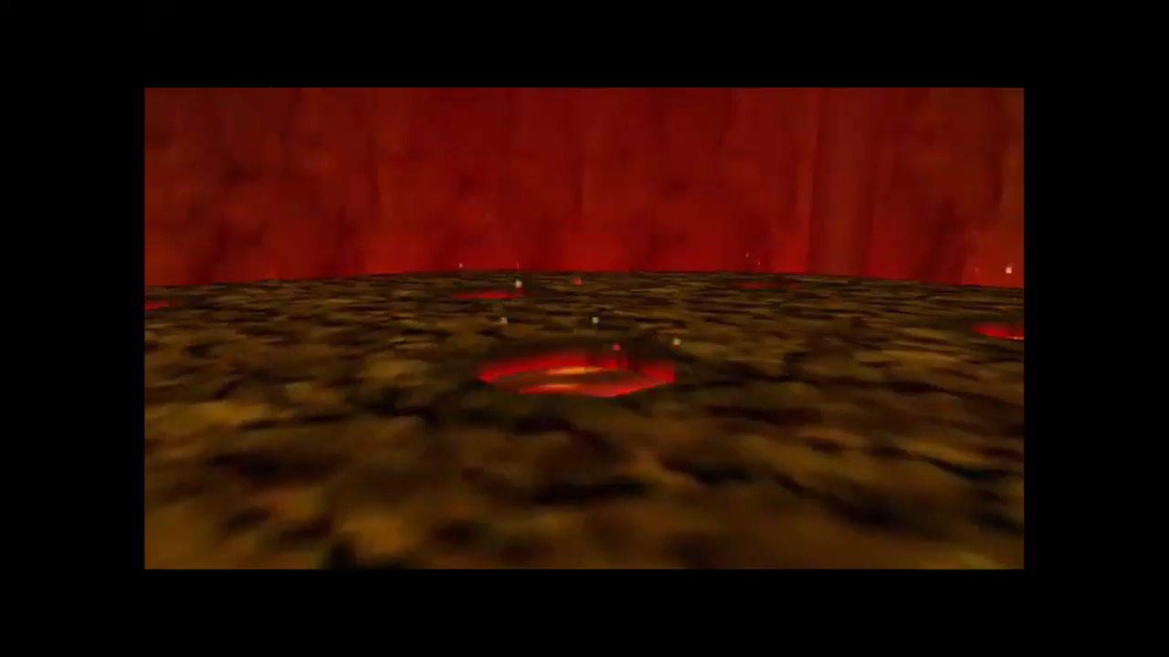
Notes:
Fire temple boss fight from Zelda OAT
Snake from Devils Daggers

Slide 4
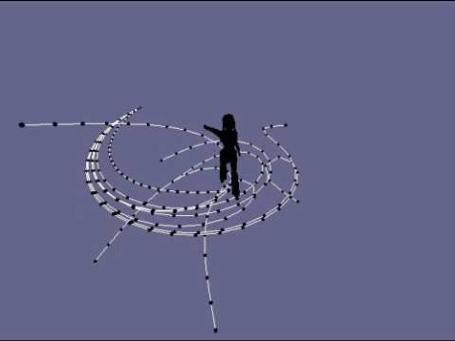
Snake Motion (Inverse Kinematics)
Array of vec3s
Iterate through, translate point n + 1 towards point n.

